Slide 1



Amazon Business Intelligence Analysis
Chandu M R
26/04/2025

Slide 2

Introduction & Objectives
“Amazon continues to dominate e-commerce with consistent performance, but the question remains: How can we transform good performance into exceptional customer loyalty and sustained growth?"
Project Context -
Amazon is currently performing well with strong revenue streams, but stakeholders recognize the need for strategic evolution to maintain a competitive advantage.
With changing customer expectations and increasing market competition, a data-driven approach to customer experience enhancement is urgently needed.
This project involves a comprehensive analysis of customer behavior, product performance, and operational efficiency to identify discount strategies, Prime membership enhancement, and loyalty program development opportunities.
Primary Objectives:
Develop new strategies to benefit customers through discounts and Prime perks
Identify and reward valuable customers to enhance the shopping experience
Create data-driven approaches for customer retention and acquisition.

Slide 3

Data Overview
The Dataset contains two Primary Tables: Orders Table & Customers Table, with comprehensive e-commerce data
Records span multiple years (2016-2020)
Key Data Attributes -
Transaction-level data: Order values, quantities, delivery status, ratings (Orders table)
Customer information: Demographics, age groups, geographic locations (Customers table)
Product metrics: Categories, subcategories, pricing, ratings across 45+ unique products
Operational data: Delivery types, wait times, return reasons, shipping charges
Geographic coverage: 15+ locations with revenue distribution analysis
Key Data Relationships
Relationship Modeling - One-to-many relationships between Orders & Customers Table
Data Quality Assurance -
Null Value Treatment: 8 orders with missing values were imputed using similar product analysis
Duplicate Removal: Primary keys (Customer ID, Order ID) cleaned
Format Standardization: Consistent data types across all attributes.

Slide 4

Methodology
Data Exploration & Preparation
Utilized Power Query Editor for comprehensive data cleaning and preparation.
Identified and imputed values for 8 orders with missing Unit Price and Quantity values
Removed duplicate entries for primary keys (Customer ID, Order ID).
Performance Analysis Framework
Developed Key Performance metrics, including revenue metrics, customer metrics, and operational metrics.
Derived a customer segmentation strategy including Demographic segmentation, Behavioral segmentation, geographic segmentation, and Loyalty tier segmentation.
Performed statistical analysis, like Correlation analysis between ratings and sales performance
Trend analysis to analyze the year-over-year growth pattern.
Analytical Techniques
Data Modeling: Established One-to-Many relationships between the Customers and Orders tables
DAX Implementation: Created 25+ custom measures using advanced DAX functions
Time Intelligence functions (SAMEPERIODLASTYEAR, DATEADD)
Statistical functions (AVERAGE, DISTINCTCOUNT, RANKX)
Conditional logic (CALCULATE, SWITCH, IF statements)
I

Slide 5
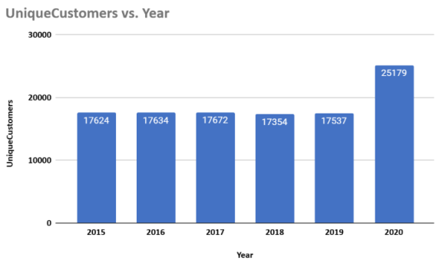

INSIGHTS
The number of customers has increased over the years, apart in 2018 and 2019, when it slightly decreased.
The number of customers increased gradually in 2020, with the highest number of customers across all years.

Slide 6
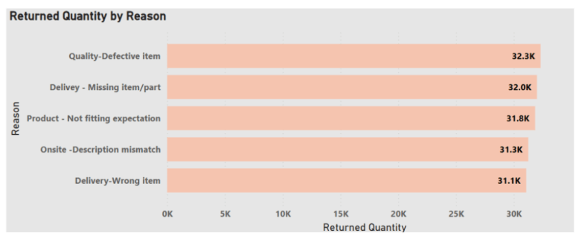
The total products returned were 163 thousand.
Quality -Defective item was the most frequent reason for returning products, followed by Delivery - Missing item/part.
Further products were returned due to Product - Not fitting Expectation. Onsite-Description mismatch and Delivery - Wrong Item.

Slide 7
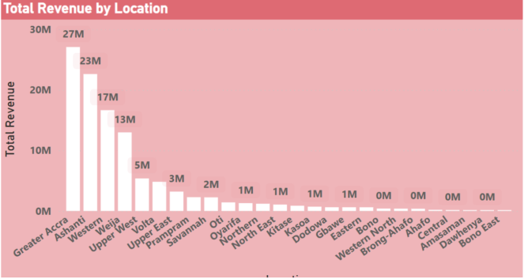
Extreme Market Concentration - The top 3 locations (Greater Accra: $27M, Ashanti: $23M, Western: $17M) generate $67M of total revenue, representing a highly concentrated market distribution.
15+ locations generate minimal revenue ($0-1M), suggesting either market saturation issues or insufficient market development.

Slide 8
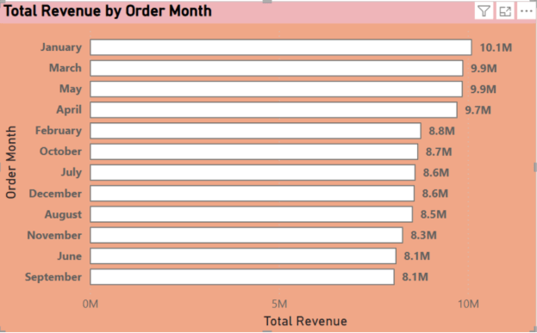
June and September: $8.1M, November: $8.3M (third lowest), and August: $8.5M (fourth lowest) appear to be the low-revenue months.
January: $10.1M (highest revenue month - likely post-holiday shopping/New Year purchases) & March & May: $9.9M each appear to be high revenue months.

Slide 9
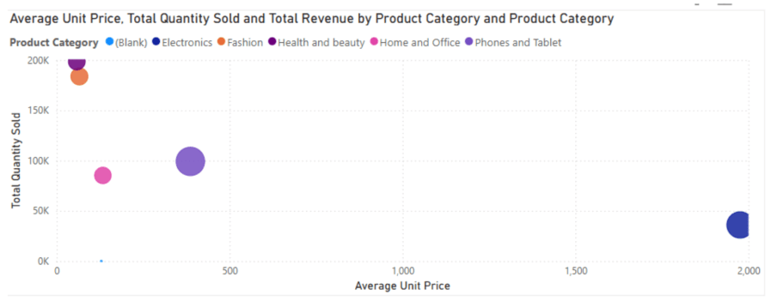
It is evident that the Electronics Product category has the highest average price per unit but has less quantity been sold.

Slide 10
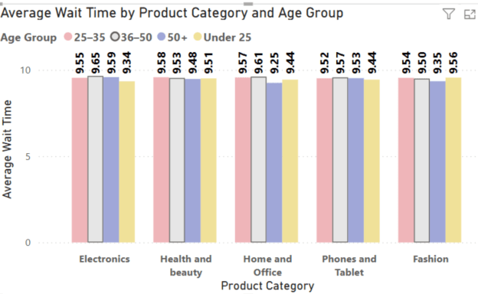
The 25-35 age group consistently shows the highest wait times across all product categories (on average 9.55-9.58 days).
The 36-50 age group has the lowest wait times across most categories (on average 9.48-9.53 days).
Under 25 and 50+ groups fall in between, with relatively similar patterns.

Slide 11
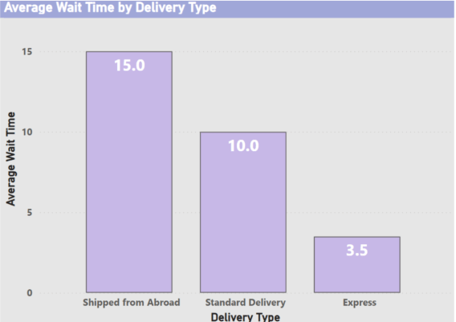
There is an inverse relationship between delivery type and average customer wait time.
Faster delivery options result in less customer wait time, while in the case of orders requiring shipments takes a much longer time.

Slide 12
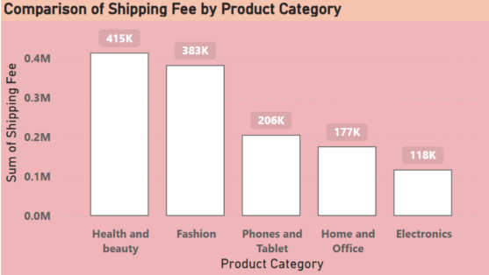
The Health and Beauty category records the highest total shipping fee at ₹ 415 K.
Fashion products contribute a substantial ₹383K to the overall shipping fees.
Phones and Tablets: ₹206K & Home and Office: ₹177K categories show moderate shipping costs.
Electronics have the lowest total shipping fee at ₹118K

Slide 13
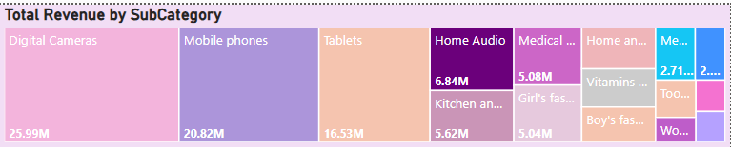
Mobile phones generate the highest subcategory revenue within electronics
Laptops represent the second-largest electronics subcategory by revenue
Kitchen appliances dominate the Home and Office category revenue
Medical equipment leads revenue generation in the Health and Beauty category
Revenue shows significant concentration in specific subcategories rather than even distribution

Slide 14
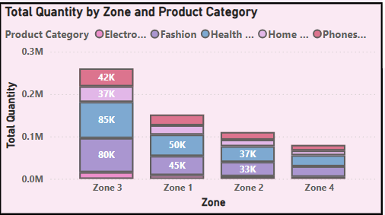
Zone 3 leads in total quantity (~0.3M units)
Fashion and Health & Beauty categories drive Zone 3 volume leadership
Zone 1 shows balanced category distribution (~0.15M units)
Zone 2 (~0.12M units) and Zone 4 (~0.08M units) show progressively lower volumes
Electronics maintain consistently low quantities across all zones

Slide 15
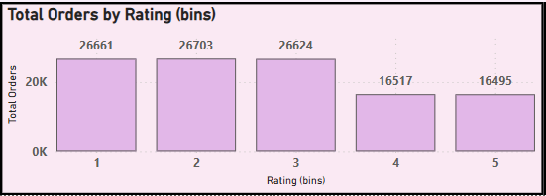
71% of orders receive ratings 1-3, indicating significant quality challenges
Rating concentration in lower categories suggests systematic quality issues

Slide 16
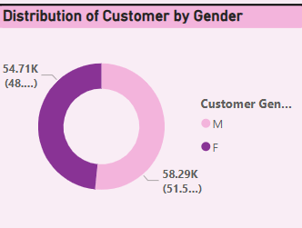
Female customers: 58.29K (51.5%)
Male customers: 54.71K (48.5%)
Gender distribution shows a balanced customer base with a slight female predominance

Slide 17
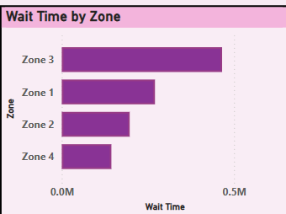
Zone 3: Longest wait times (~0.5M time units)
Zone 1: Moderate wait times (~0.3M time units)
Zone 2: Lower wait times (~0.2M time units)
Zone 4: Shortest wait times (~0.15M time units)
Zone 3 wait times are 3x longer than Zone 4

Slide 18

Strategic Recommendations
Loyalty & Customer Segmentation - Segment customers into Premium, Silver, and Bronze tiers based on spending and frequency, offering cashback, free shipping, early access to deals, and VIP perks to drive repeat purchases.
b. Targeted Discounts & Bundles - Focus on high-priced, slow-moving products with decent ratings. Use strategic discounts and bundle them with accessories or complementary items to increase value and boost conversions.
c. Seasonal Promotions - Address dips in June and September through campaigns like "Mid-Year Mega Sale" and "Back-to-School Boost," tailored to seasonal buying behavior and top product categories.

Slide 19
d. Regional Market Focus - Prioritize high-performing regions like Greater Accra and Ashanti for premium experiences. In underperforming regions, use localized campaigns and logistics improvements to grow market share.
e. Delivery Experience Upgrade - Long delays for overseas orders impact satisfaction. Flag longer wait times at checkout, offer Express Delivery as a perk, and stock high-demand items locally to reduce delays.
f. Reduce Returns with Better Listings - Returns driven by quality and expectation mismatches can be reduced by improving product descriptions, implementing stricter supplier standards, and using packaging verification tools.
g. Fix Low-Rated High-Revenue Products - High-revenue items with low ratings (like tablets and phones) need focused quality improvements. Use customer reviews to identify fixes and incentivize feedback through loyalty rewards.

Slide 20
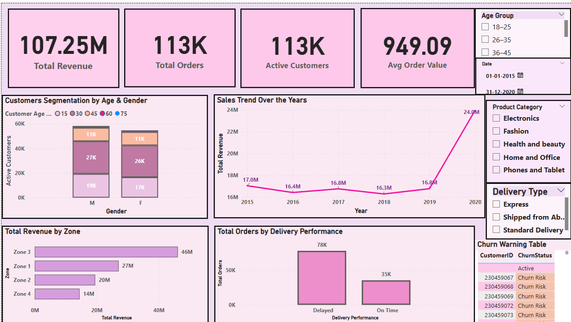

Slide 21
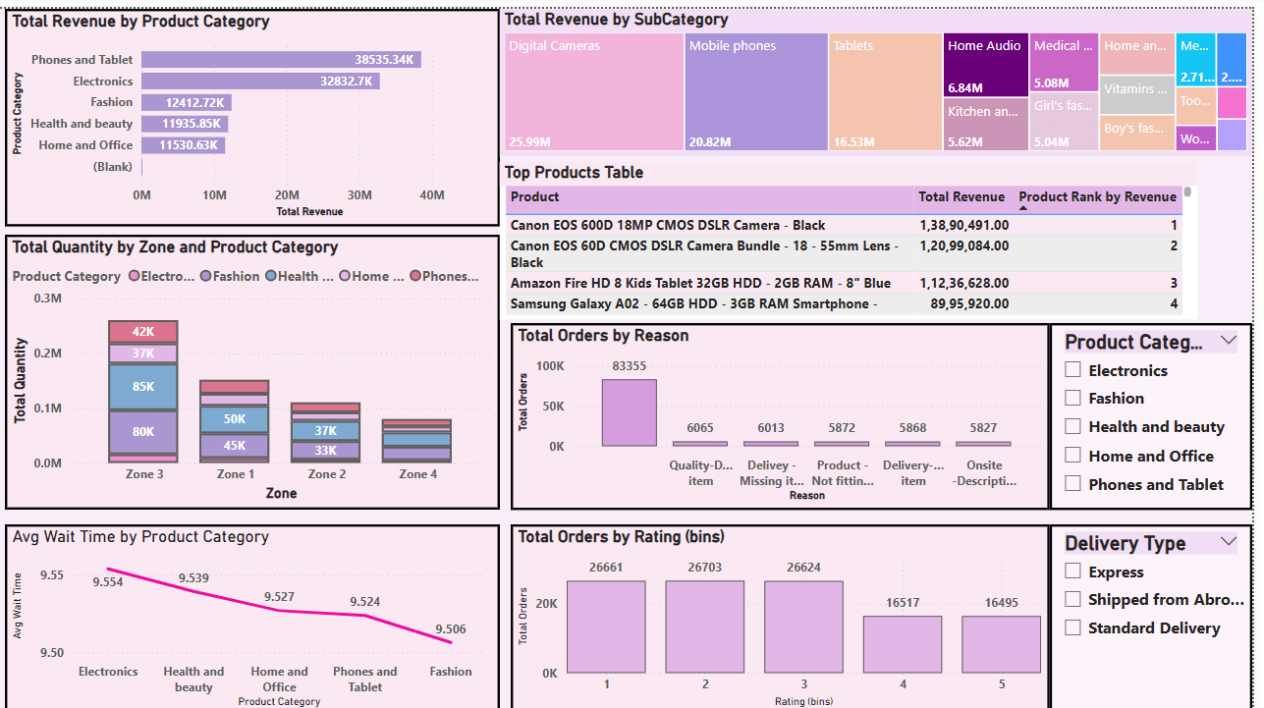
Product Dashboard

Slide 22
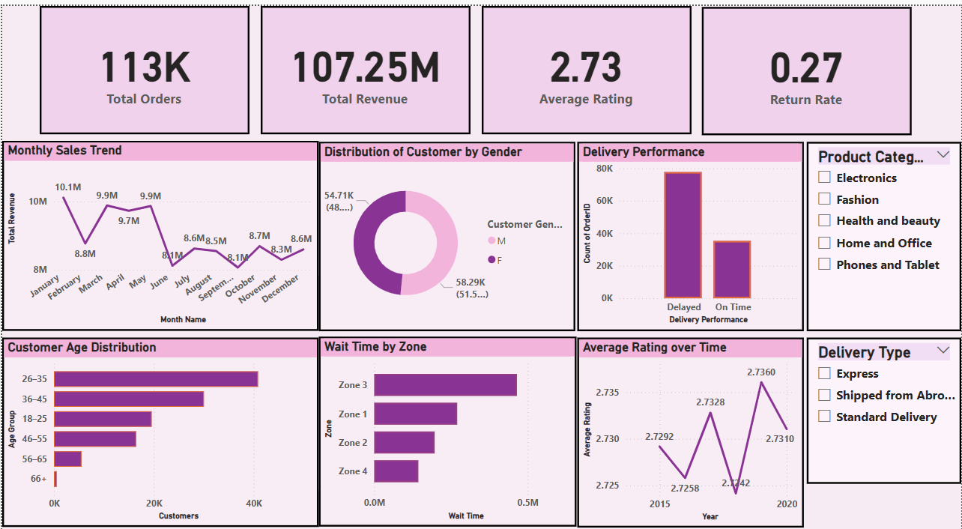
Individual Product Dashboard

Slide 23
Conclusion
Customer Insights
The analysis revealed that high sales are not always driven by ratings—necessity, pricing, and delivery experience play a more influential role. Customer segmentation highlighted a vast untapped base for loyalty engagement.
Business Opportunities
Introducing loyalty tiers, optimizing delivery options, and launching seasonal campaigns can directly address these challenges. Regional marketing and bundling strategies further position Amazon to grow efficiently while improving customer experience.
“This analysis empowers Amazon to act with precision—turning data into direction, and customer insights into business advantage.”

Slide 24


Thank you very much!

